Slide 1
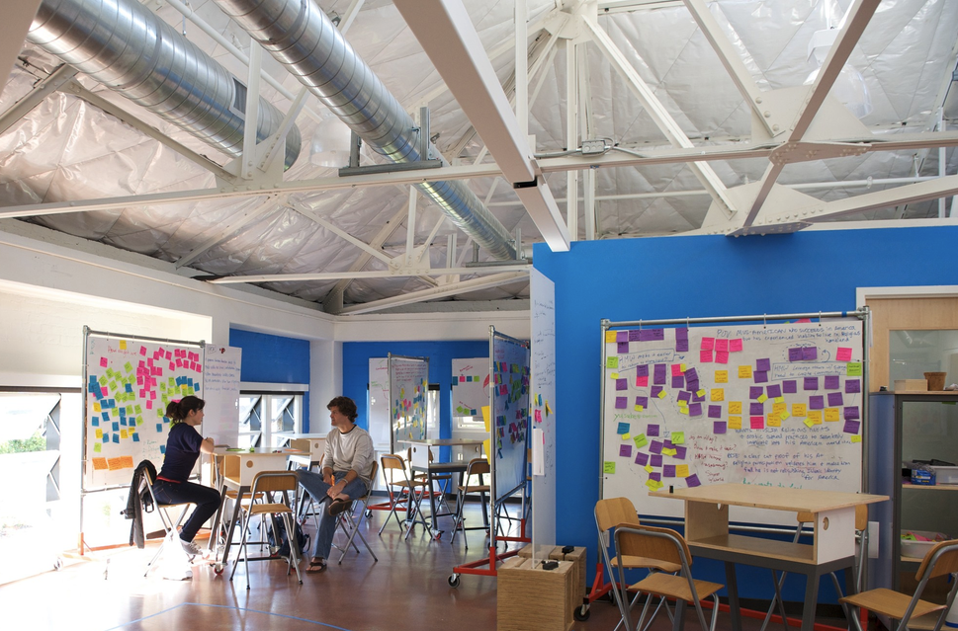
What the d.school is
STANFORD D.SCHOOL · 1 OF 4
Formally the Hasso Plattner Institute of Design at Stanford, founded in 2005
Started by David Kelley of IDEO, with funding from SAP co-founder Hasso Plattner
A cross-campus hub: students from every Stanford school take project-based, team-taught classes
Led by Executive Director Sarah Stein Greenberg since 2014
Source: dschool.stanford.edu
Notes:
The name is short for "design school". It is not a traditional department: it began as an institute any Stanford student could take classes in, whatever their major. David Kelley founded the design firm IDEO; Hasso Plattner co-founded SAP and funded the institute, which is why it carries his name. Sarah Stein Greenberg has been Executive Director since 2014.

Slide 2
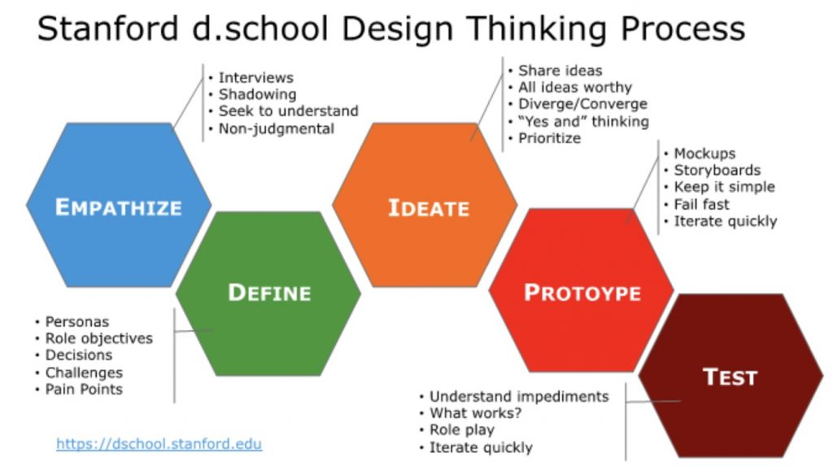
How it teaches design thinking
STANFORD D.SCHOOL · 2 OF 4
Empathize: watch and interview the people you are designing for
Define: frame the real problem from what you learned
Ideate: generate many options before judging any
Prototype: build something quick and cheap to make the idea concrete
Test: put it in front of users, learn, and loop back
Source: dschool.stanford.edu
Notes:
This five-step model is what most people mean by "design thinking". The steps are not strictly linear: teams loop back from testing to redefining the problem. The emphasis is on starting from real users rather than from a technology, and on building rough prototypes early instead of planning at length.

Slide 3
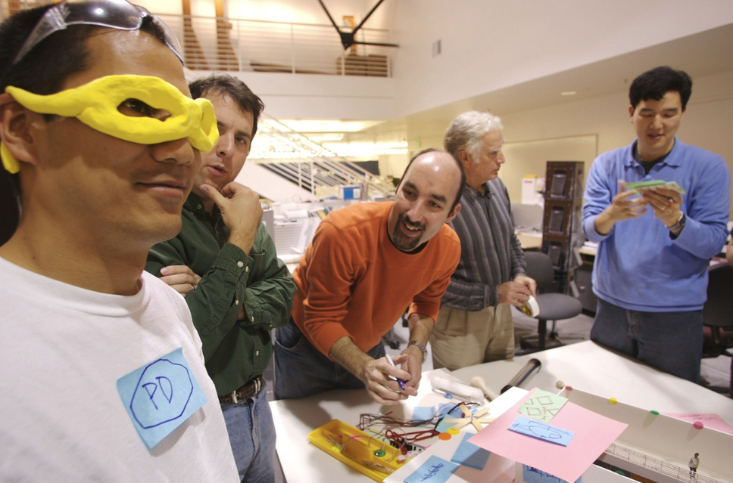
What it has produced
STANFORD D.SCHOOL · 3 OF 4
Ventures from the classroom: Design for Extreme Affordability led to Embrace (infant warmer) and d.light (solar lighting)
Degrees: now home to Stanford's two relaunched design degrees
Beyond students: executive education, a K12 Lab, and a 12-book series on design
A global model: a sister school at HPI in Potsdam and many imitators worldwide
Source: dschool.stanford.edu
Notes:
Embrace is a low-cost infant warmer for premature babies where incubators are unavailable; d.light makes affordable solar lanterns for homes without electricity. Both began as student projects in the Design for Extreme Affordability course. The Potsdam sister school is the HPI School of Design Thinking, also funded by Hasso Plattner.

Slide 4
Core messages: what the d.school stands for
STANFORD D.SCHOOL · 4 OF 4
01
Start with people
02
Build to think
Begin with the needs of real users, not with a technology looking for a use.
Make a rough prototype early and learn from testing it instead of planning at length.
03
Mix the disciplines
04
Creativity can be taught
Engineers, doctors and MBAs work on one team, because hard problems cross fields.
Everyone can learn to innovate with practice. It is a skill, not a gift.
So what? The d.school treats innovation as a method anyone can learn and practice.
Summary of the d.school’s design thinking mindsets (dschool.stanford.edu)
Notes:
This is the "so what" slide. The d.school stands for four ideas: start from real people rather than from a technology; build rough prototypes early and learn by testing; put different disciplines on one team; and treat creativity as a skill that can be taught, which David Kelley calls creative confidence. The single takeaway: innovation is a method anyone can learn.

